Slide 1
Lesson 22: Determining Control Stability Using Bode Plots
ET 438a Automatic Control Systems Technology

Slide 2
Learning Objectives
After this presentation you will be able to:
List the control stability criteria for open loop frequency response.
Identify the gain and phase margins necessary for a stable control system.
Use a Bode plot to determine if a control system is stable or unstable.
Generate Bode plots of control systems the include dead-time delay and determine system stability.

Slide 3
Bode Plot Stability Criteria
Open loop gain of less than 1 (G<1 or G<0dB) at open loop phase angle of -180 degrees
Stable Control
System
Oscillatory Control System
Marginally Stable
Open loop gain of exactly 1 (G=1 or G= 0dB) at open loop phase angle of -180 degrees
Unstable Control System
Open loop gain of greater than 1 (G>1 or G>0dB) at open loop phase angle of -180 degrees

Slide 4
Phase and Gain Margins
Inherent error and inaccuracies require ranges of phase shift and gain to insure stability.
Gain Margin – Safe level below 1 required for stability Minimum level : G=0.5 or -6 dB at phase shift of 180 degrees
Phase Margin – Safe level above -180 degrees required for stability Minimum level : φ=40 degree or -180+ 40=-140 degrees at gain level of 0.5 or 0 dB.

Slide 5
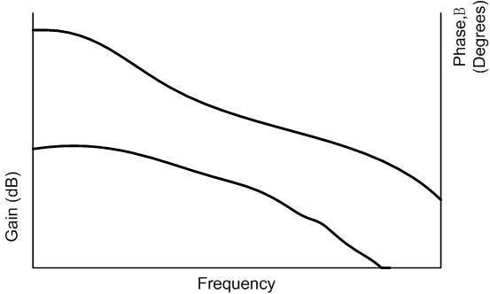
Determining Phase and Gain Margins
Define two frequencies: ω_{odB} = frequency of 0 dB gain
ω₁₈₀ = frequency of -180 degree phase shift
Open Loop Gain
0 dB
Gain Margin
-m₁₈₀
β_{odB}
Phase Margin
-180+β_{0dB}
-180º
Open Loop Phase
ω_{odB}
ω₁₈₀

Slide 6
Determining Phase and Gain Margins
Procedure: 1) Draw vertical lines through 0 dB on gain and -180 on phase plots.
2) Draw horizontal lines through 0 dB and -180 so that they intersect with the vertical lines.
3.) Draw two more horizontal lines that intersect the -180 line on the gain plot and the 0 dB line on the phase plot.
0 dB
1
1
2
Read Gain Margin
-m₁₈₀ dB
3
Read Phase Margin
here -180+β_{0dB}
2
-180º
ω_{odB}
ω₁₈₀

Slide 7
Stability Analysis Using Bode Plots
Bode plot stability analysis is idea for systems with dead-time delay. Delay represented by phase shift that increases with frequency.
Example 22-1: A first order lag process has a dead-time delay of 2 seconds and is controlled by a proportional controller. The open loop transfer function is:
Find the magnitude and phase angle of the transfer function at the following frequencies: ω=0.001, 0.01, 0.1 and 1 radian/sec using hand calculations.
Use MatLAB and construct the Bode plots of the system and then determine the gain and phase margin of the system.

Slide 8
Example 22-1 Solution (1)
Substitute jω=s
Where
For jω=j0.001

Slide 9
Example 22-1 Solution (2)
For jω=j0.01
For jω=j0.1

Slide 10
Example 22-1 Solution (3)
For jω=j0.1 cont.
For jω=j1

Slide 11
Example 22-1 Solution (4)
Calculation summary
Convert all magnitudes
to decibels
Frequency (rad/sec) | GH | GH (dB)
0.001 | 39.8∠-5.83° | 32∠-5.83° dB
0.01 | 28.28∠-46.15° | 29∠-46.15° dB
0.1 | 3.98∠-95.82° | 12∠-95.82° dB
1.0 | 0.4∠-204.6° | -8 ∠-204.6° dB

Slide 12
Example 22-1 Solution (5)
Construct an open-loop Bode plot using MatLAB and find the gain and phase margins for the control system. Example code follows:
clear all;
close all;
numgh=[40]; % define the forward gain numerator and denominator coefficients
demgh=[100 1];
Gh=tf(numgh,demgh); % construct the transfer function
[m p w]=bode(Gh,{0.001,1}); % Use the bode function with its arguments so that it returns the
% magnitude, m, the phase shift, p and the frequencies so that
% the effect of the dead time delay can be added to the system
% now compute the values of phase shift for the time delay using % the formula -2*w*57.6
pd=-2*w*57.6;

Slide 13
Example 22-1 Solution (6)
% Add the phase shift of the transfer function to the dead-time delay
% take the phase shift out of the 3 column array [m p w]
phase=p(:);
pt=pd+phase;
db=20.*log10(m); % compute the gain in db
figure; % create a figure window
subplot(2,1,1); % divide the plot area in two parts
semilogx(w,db,'go-'); %plot gain in dB on a semilog x-axis
xlabel('Frequency (rad/sec)'); % add labels and title. Turn on the grid.
ylabel('Gain (db)');
title('Example Bode Plot');
grid on;
subplot(2,1,2); % now do the same for the phase shift plot
semilogx(w,pt,'go-');
xlabel('Frequency (rad/sec)');
ylabel('Phase Shift (Degrees)');
grid on

Slide 14
Example 22-1 Solution (7)
Gain Margin
-6 dB
Phase Margin
β=45°
180-135 =45

Slide 15
End Lesson 22: Determining Control Stability Using Bode Plots
ET 438a Automatic Control Systems Technology

